Slide 1
EECS 490 – Lecture 4 Memory Management

Slide 2
Announcements
Homework 1 due tomorrow at 8pm
Project 1 due Wed 9/20 at 8pm

Slide 3
Agenda
Storage Duration
Value and Reference Semantics
RAII and Scope-Based Resource Management
Garbage Collection

Slide 4
Static Storage
Variables at global, namespace, or static class scope can be accessed at any time, so the associated object's lifetime must span the whole program
Compiler/linker can determine which objects have static storage duration, so they are often placed in a special data segment
C and C++ allow local variables to have static storage duration with the static keyword
In some languages, initialization of static objects may be deferred until first use

Slide 5
Automatic Storage
Non-static local variables come into existence upon entry to their function or block
Stored inside activation record or frame for the block
Frame created when block is entered, destroyed upon final exit from block void foo(int x) { int y = x * x; if (y < 100) { int z = 100 - y; cout << z << endl; } cout << y << endl; }

Slide 6
Stack-Based Memory Management
In many languages, activation records are stored on a stack
Upon creation, frame pushed onto stack
Upon final exit, frame popped from stack
Cannot be used in languages with full support for nested function definitions
Static (lexical) scope requires access to definition environment even after associated function exits def foo(x): def bar(y): return x + y return bar fn = foo(3) fn(4)

Slide 7
Dynamic Storage
Objects that are not tied to a specific scope have dynamic storage duration
Compiler cannot deduce lifetime from code
Usually created explicitly by programmer
Examples: malloc(4 * sizeof int), new int[4]
Dynamic objects cannot be placed on stack, since their lifetime can exceed that of the block where they are created
Instead, a special structure called a heap is used to store dynamic objects

Slide 8
Managing Dynamic Storage
Language runtime must provide heap management
Find free space when dynamic object is allocated, manage free space when objects are deallocated
Objects must be reclaimed when they are no longer in use
User-level management: explicit calls to free(), delete
Automatic memory management: garbage collection
More on this later

Slide 9
Agenda
Storage Duration
Value and Reference Semantics
RAII and Scope-Based Resource Management
Garbage Collection

Slide 10
Value and Reference Semantics
Value semantics: a variable is nothing more than a name associated with an object
The storage for the variable is the same as that of the object itself
The association between a variable and an object cannot be broken as long as the variable is in scope
Reference semantics: a variable is an indirect reference to an object
A variable has its own storage that is distinct from that of the object it refers to
A variable can be modified to be associated with a different object

Slide 11
Variables in C++
Declaring a variable creates an associated object in memory int x = 3; cout << &x << endl; x = 4; cout << &x << endl;
Changes the value stored in the object, not which object x refers to
Notes:
Draw stack frame.

Slide 12
C++ References
A reference in C++ is just an alias for an existing object int x = 3; int &y = x; cout << &x << endl; cout << &y << endl; y = 4; cout << x << endl;
Notes:
Draw stack frame.

Slide 13
Pointers
A pointer is a kind of object whose value is the address of another object
Refer to objects indirectly, so they provide a form of reference semantics int x = 3; int y = 4; int *z = &x; z = &y; *z = 5; cout << x << ", " << y << endl;
Changes which object z indirectly "refers to"
Notes:
Draw stack frame.

Slide 14
Reference Semantics
In a language with reference semantics, variables behave like C/C++ pointers
But can't do arithmetic on them
Example: C++ equivalent: >>> x = [] list *x = new list(); >>> y = x list *y = x; >>> id(x) cout << x << endl; 4546751752 >>> id(y) cout << y << endl; 4546751752
Python: everything has reference semantics
Java: primitives have value semantics, everything else has reference semantics
Get unique ID of object

Slide 15
Reference Semantics vs. C++ References
Java/Python references are not the same as C++ references
Java/Python: a reference indirectly refers to an object, can be changed >>> x = [] >>> id(x) 4546749256 >>> id(y) 4546751752
C++: a reference is an alias for an object, cannot be changed

Slide 16
Break Time!
We’ll start again in five minutes.

Slide 17
Agenda
Storage Duration
Value and Reference Semantics
RAII and Scope-Based Resource Management
Garbage Collection

Slide 18
Internal Resources
A data abstraction may have its own internal resources that it manages
Example: vector
Allocates storage space upon construction
Upon insertion, if space is exhausted, allocates larger space, moves items, deallocates old storage
Internal resources are part of the implementation, and the user of an abstraction should not have to manage its internal resources
Internal memory automatically handled in garbage-collected languages

Slide 19
Dispose Pattern
Extend the interface of an abstraction to provide functions that must be called when the abstraction is created and when it is no longer needed
Example: typedef struct { ... } vector; void vector_init(vector *); void vector_destroy(vector *);
Relies on user to remember to call both functions at the appropriate times
Analogous to malloc(), free()

Slide 20
Constructors and Destructors
Initialization functions formalized in object-oriented languages as constructors
Some languages formalize destruction functions as destructors
Garbage-collected languages provide finalizers instead; more on this later
A language can ensure that a constructor is always called when an object is created, and the destructor when it is destroyed
Static objects: upon program start and end
Automatic objects: when they go in and out of scope
Dynamic objects: when new or delete is applied to them

Slide 21
Resource Acquisition is Initialization (RAII)
General pattern for resource management using constructors and destructors
Also called scope-based resource management
Example: int main() { vector<int> values; { ifstream input("some_file"); int x; while (input >> x) values.push_back(x); } ... }

Slide 22
Scope-Based Resource Management
RAII generally does not work for non-memory resources in garbage-collected languages
Some languages provide specific constructs for scope-based resource management
Example: with open('some_file') as f: values = [int(x) for x in f.read().split()]

Slide 23
Agenda
Storage Duration
Value and Reference Semantics
RAII and Scope-Based Resource Management
Garbage Collection

Slide 24
Garbage Collection
Languages that provide automatic memory management must implement a means of detecting when objects are no longer in use and collecting them def foo(): a = list() # object A b = a b = list() # object B a = None # A no longer in use return # B no longer in use after return
Main types of garbage collection:
Reference counting
Tracing collectors

Slide 25
Reference Counting
Each object has a count of the number of pointers or references to it def foo(): a = list() b = a b = list() a = None return
When the count of an object reaches 0, it is garbage and is collected
Object A
Assignment to b sets A's count to 2
Assignment to a sets A's count to 1
Object B
Assigning B to b sets B's count to 1 and A's to 1
Assignment to a sets A's count to 0
Return sets B's count to 0

Slide 26
Circular References
Reference counting fails to detect garbage with circular references
Implementations such as CPython include cycle detection algorithms
Languages also might provide weak pointers (or references) that do not increment reference count
size: 3
first:
last:
datum: 1
next:
prev: 0
datum: 2
next:
prev:
datum: 3
next: 0
prev:

Slide 27
C++ Smart Pointers
Pointer-like objects that do reference counting shared_ptr<Object> p1(new Object()); shared_ptr<Object> p2 = p1; // count is now 2 p1.reset(); // count decremented to 1 p2 = nullptr; // count decremented, object deleted
shared_ptr: reference counting pointer, deletes an object when count is 0
weak_ptr: weak pointer that does not increment count
unique_ptr: ensures that only one pointer to an object exists at a time

Slide 28
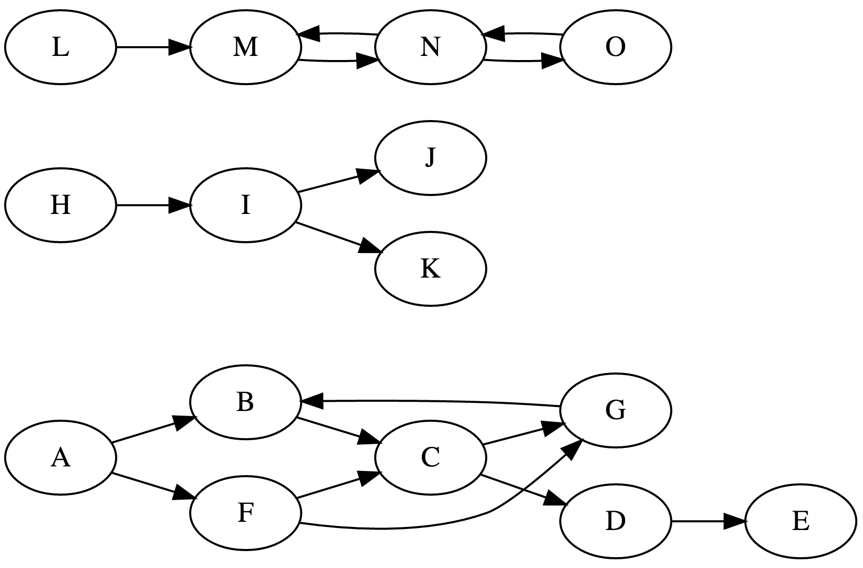
Tracing Collectors
Periodic collection
Start out from root set of objects
Generally those with static and automatic duration¹
Recursively follow all pointers/references
Objects that are reached are live, rest are dead
Mark and sweep: mark all objects reached during search, then sweep rest
Stop and copy: copy objects to new locations as they are encountered
Need to change pointers

Slide 29
Finalizers
Analogous to destructor, called when an object is about to be collected
Java: finalize()
Python: __del__()
Problems
May not be called in a timely manner, particularly with tracing collectors
Can lead to object resurrection if a reference to the object is leaked
Do not run in a well-defined order
Are not guaranteed to run in many implementations

